Slide 1




Using ML to
Track Sleep
Project Leader: Max Emerling
Members: Hannah Huang, Nathan Juan, Rachel Lee, Nisha Prabhakar, Mehul Raheja, Patrick Wang
UC Berkeley Launchpad
Spring 2021 Showcase

Slide 2
We like to sleep.
Track it.
How do we help ourselves get more of it?
Notes:
Max, Nathan

Slide 3
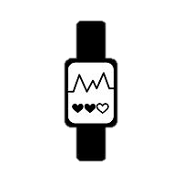

Current Methods
Sleep Labs
Wearable Technology
Accurate
Expensive
Uncomfortable sensors
Sleep professionals needed
Relatively Inexpensive
Convenient
Inaccurate
Notes:
Max, Nathan

Slide 4
What’s the solution?
Notes:
Max, Nathan

Slide 5
Radio Frequency Data
Predicted Sleep Stages
ML Model
Notes:
Max, Nathan

Slide 6
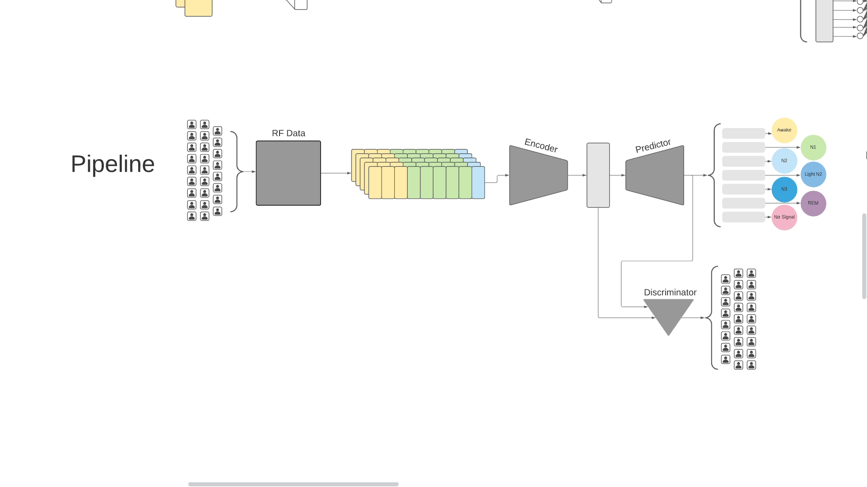
Overall Model
Three-Part Network
Encoder
Label Predictor
Source Discriminator
Notes:
Max, Nathan

Slide 7
Training the Model
Notes:
Hannah, Mehul

Slide 8
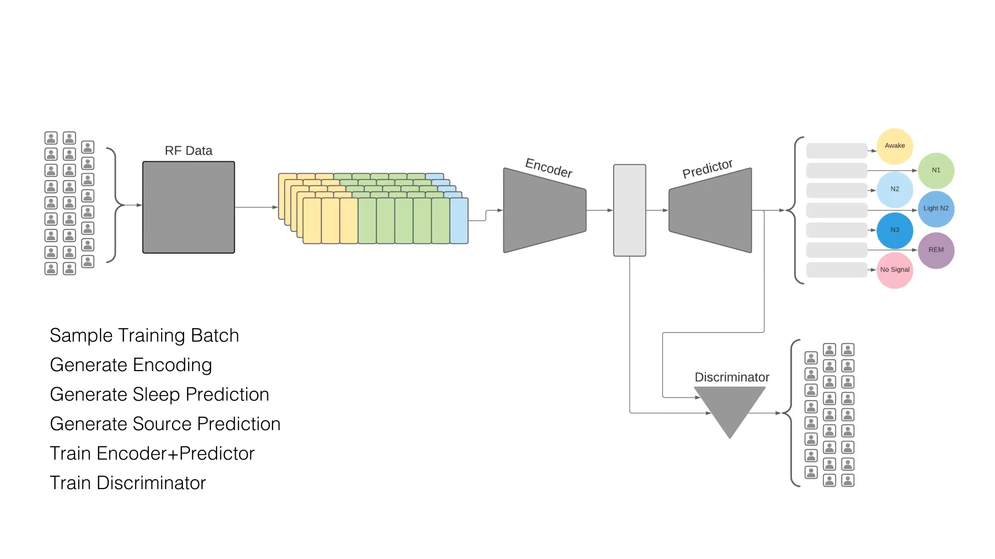
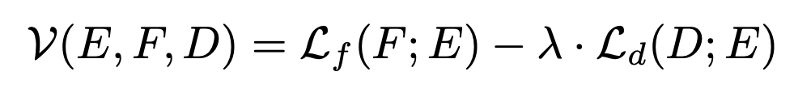
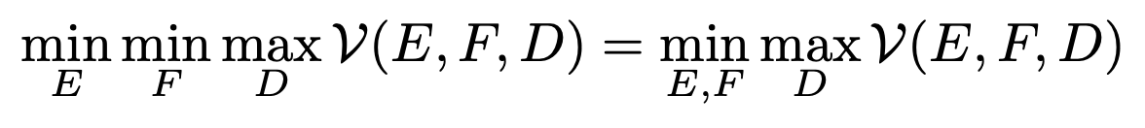
Notes:
Hannah, Mehul

Slide 9
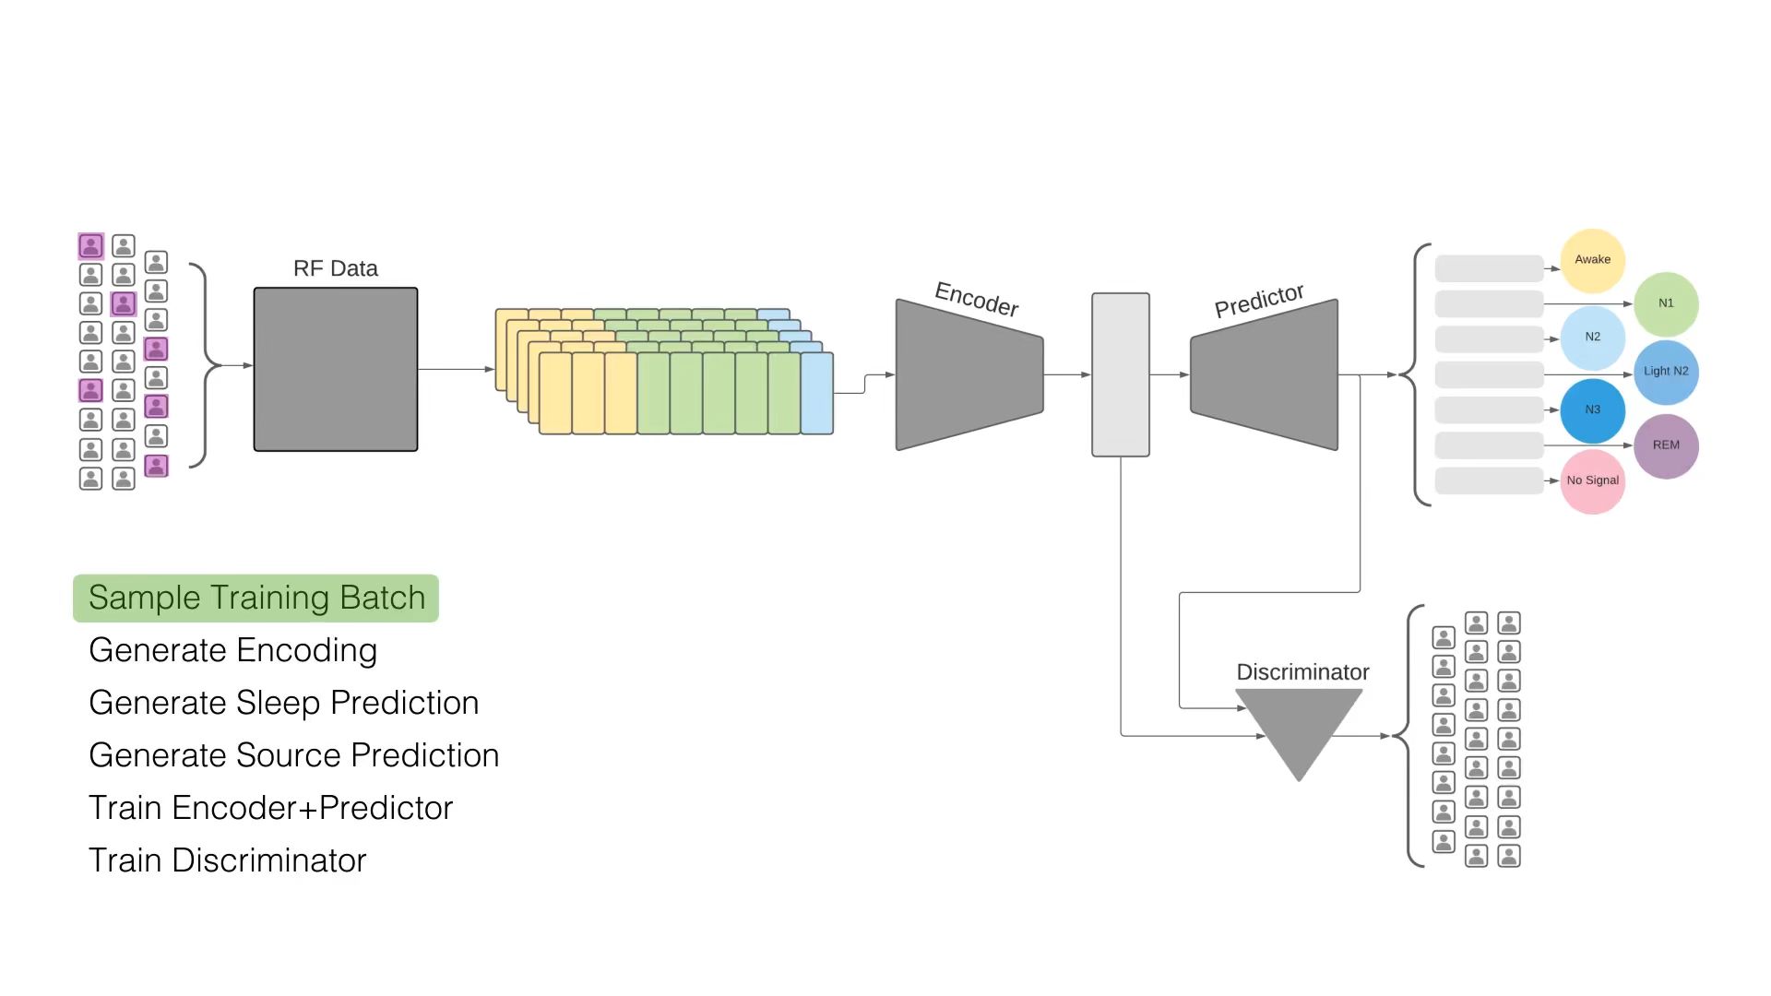
Notes:
Hannah, Mehul

Slide 10
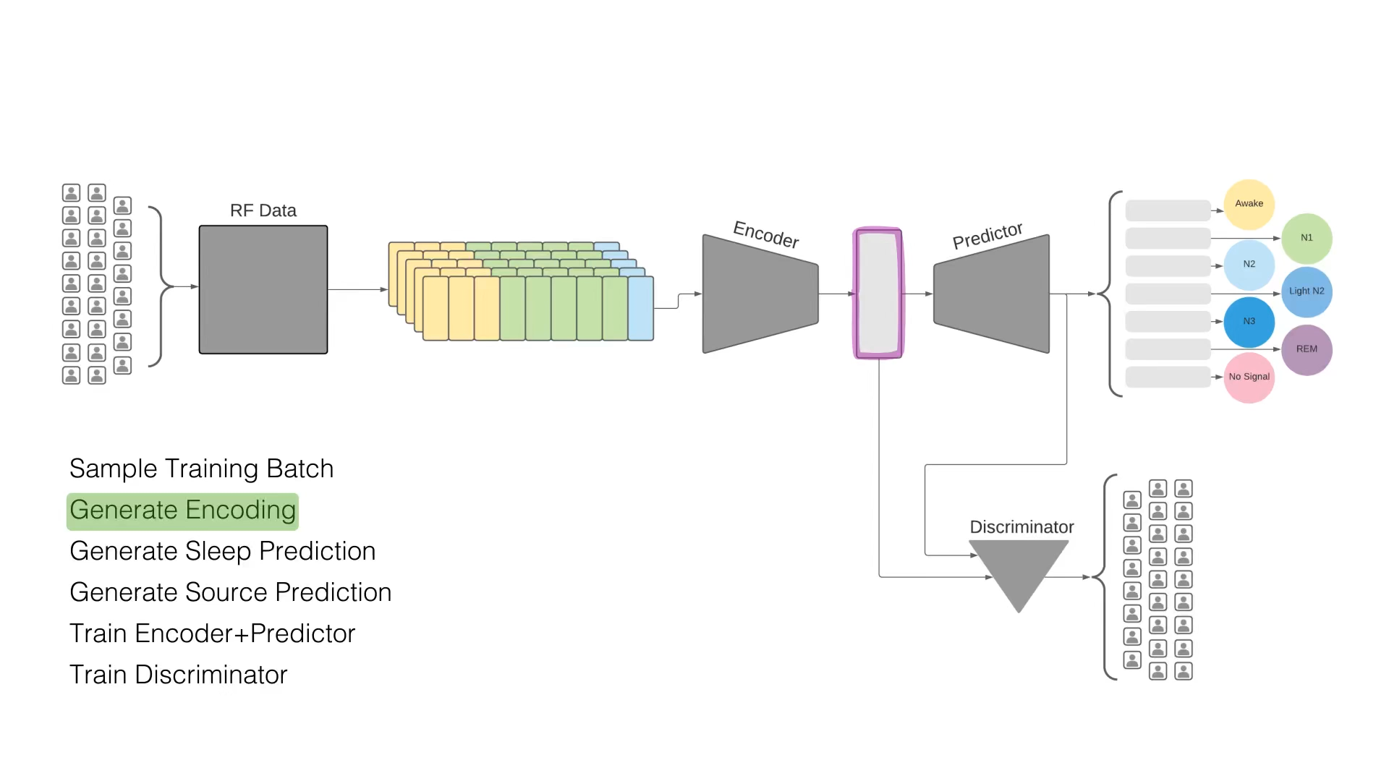
Notes:
Hannah, Mehul

Slide 11
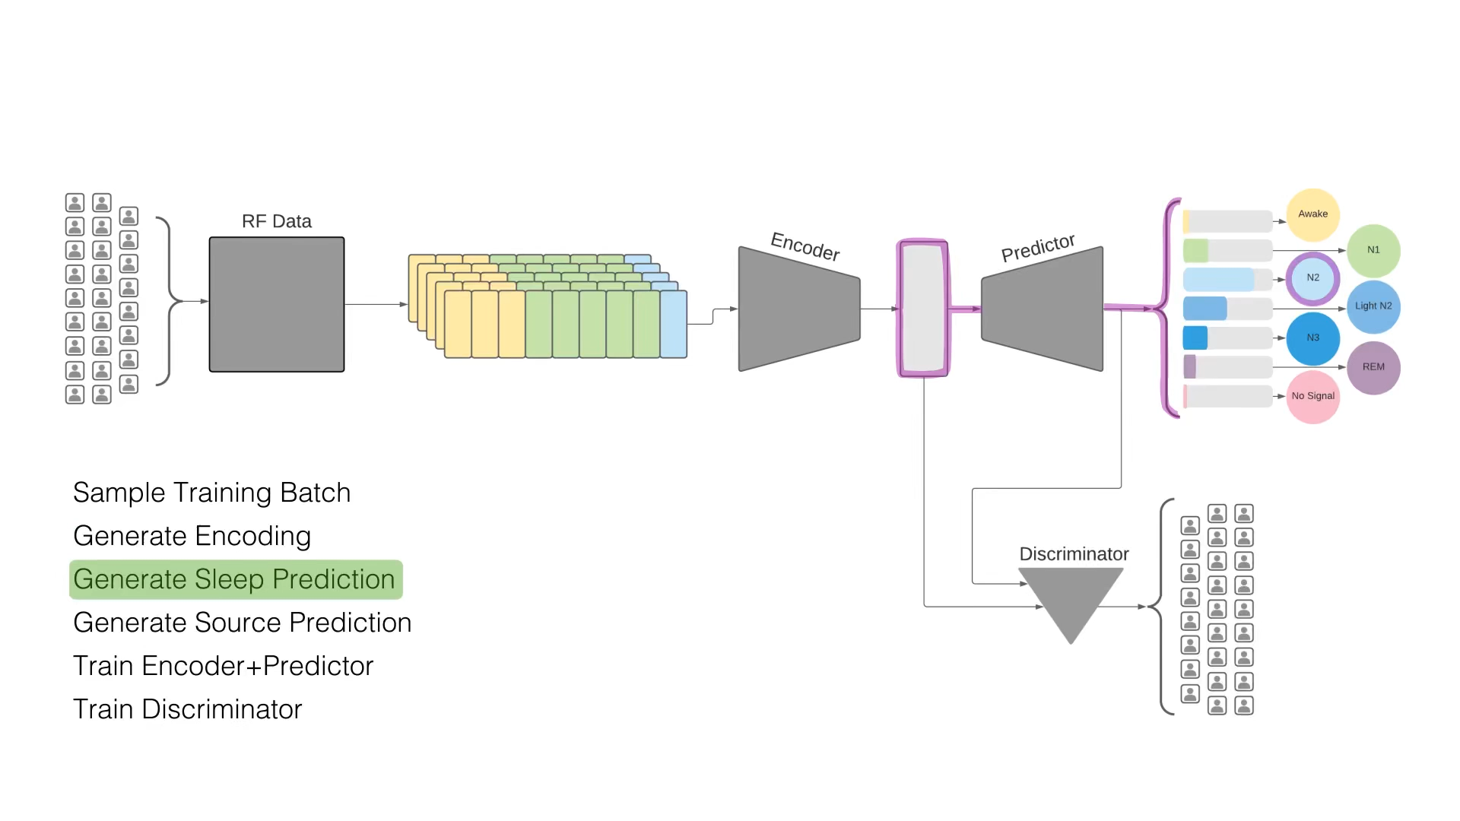
Notes:
Hannah, Mehul

Slide 12
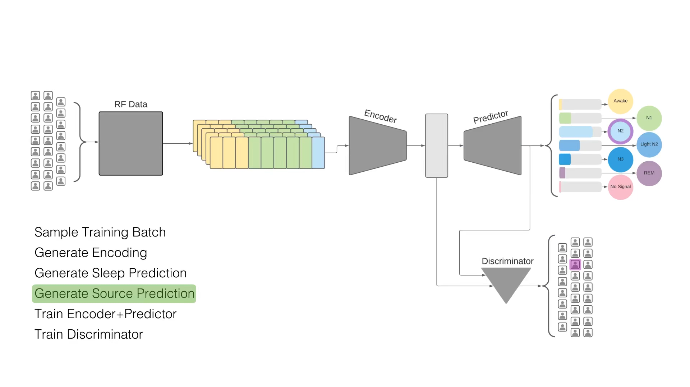
Notes:
Hannah, Mehul

Slide 13
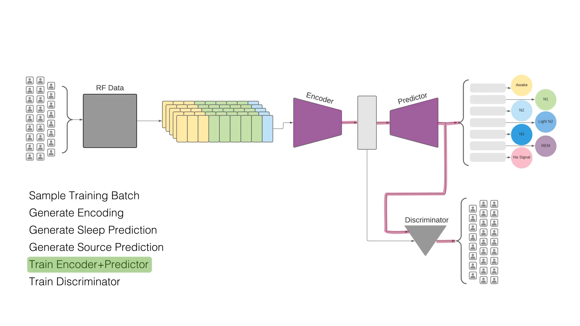
Notes:
Hannah, Mehul

Slide 14
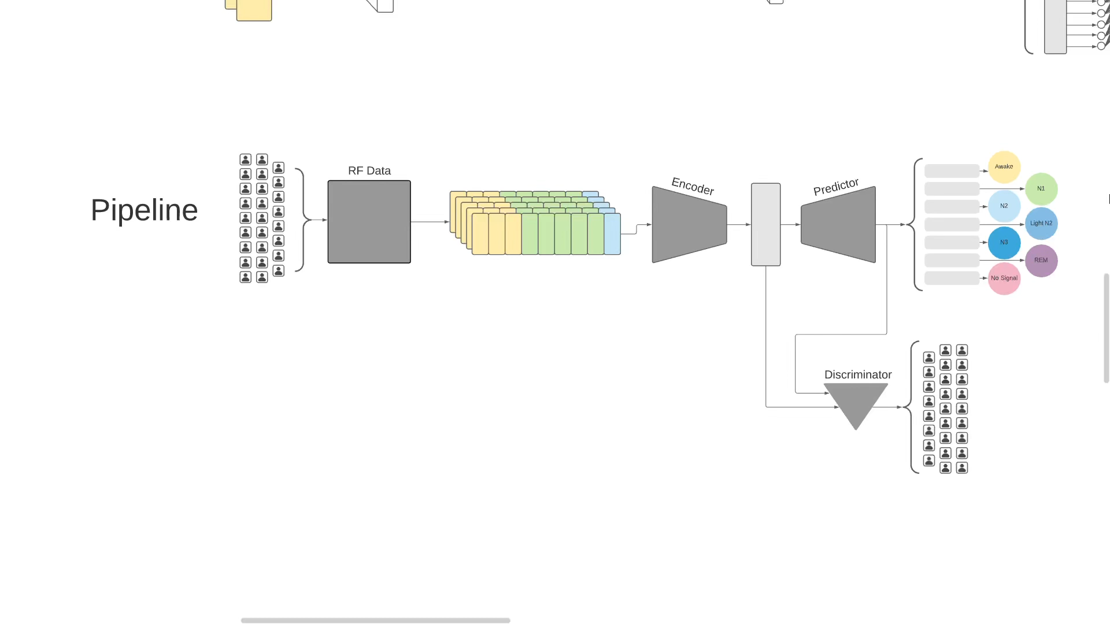
Model Architecture
Sleep Stage Predictor
Notes:
Patrick, Nathan

Slide 15
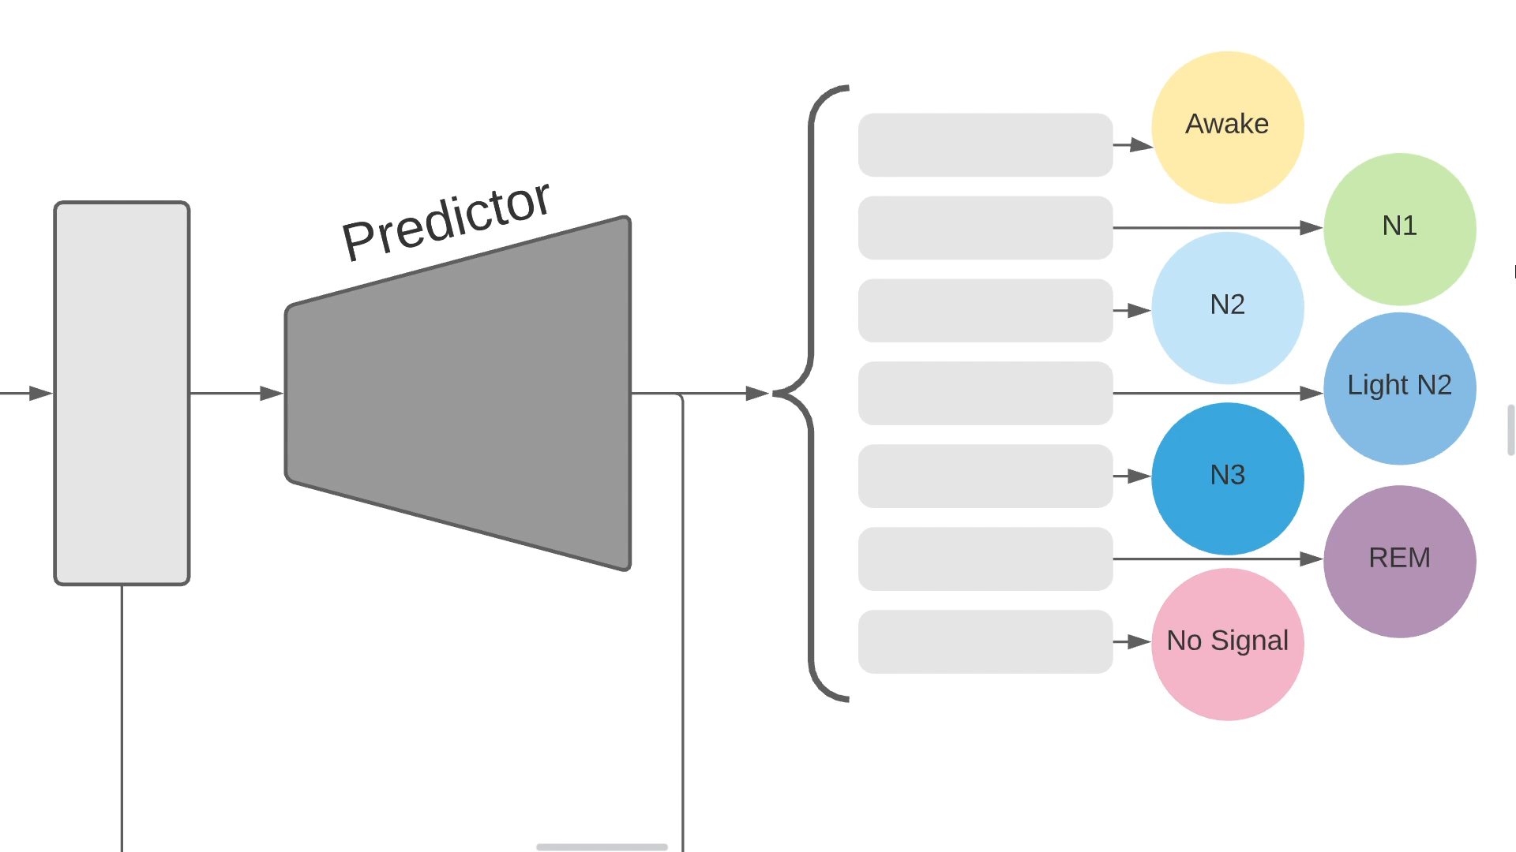
Model Architecture
Sleep Stage Predictor
Notes:
Patrick, Nathan

Slide 16
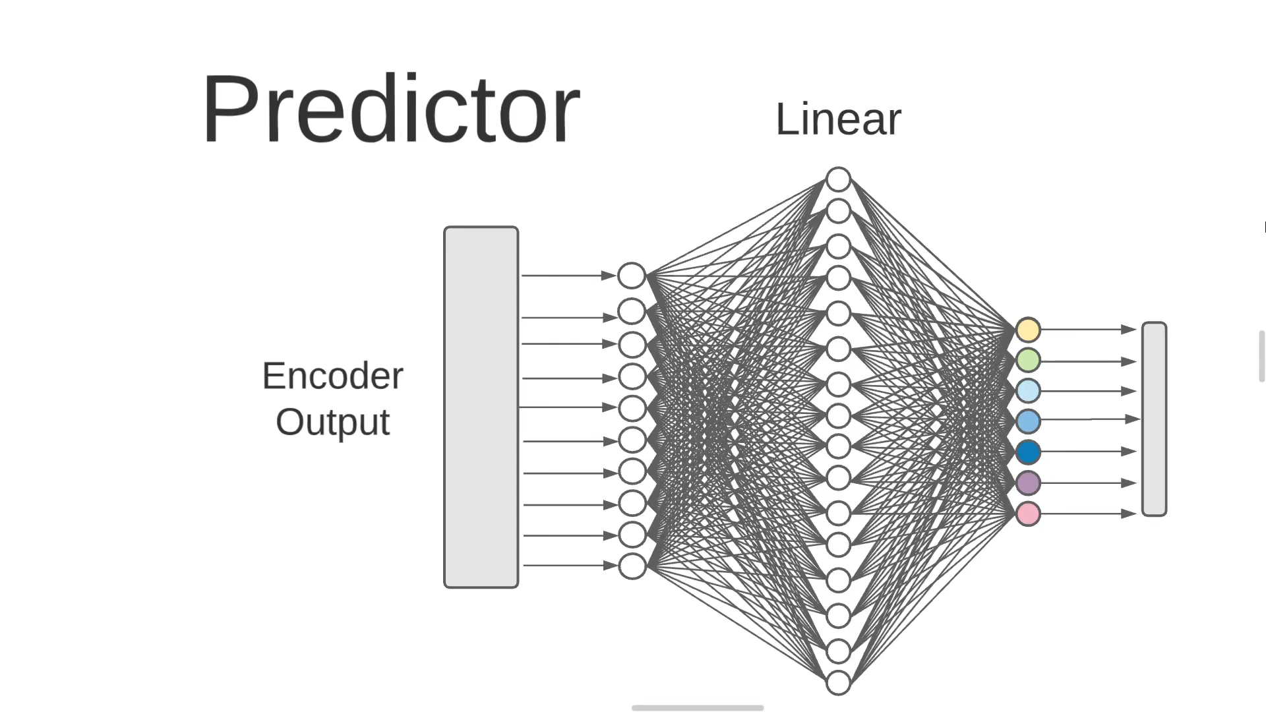
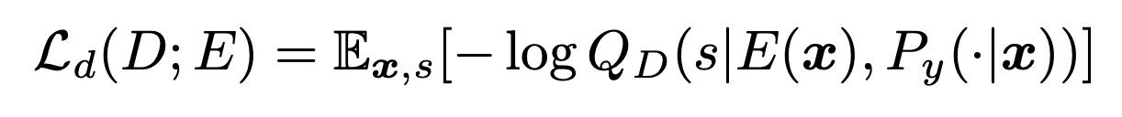
Model Architecture
Source Discriminator
Sleep Stage Predictor
Notes:
Patrick, Nathan

Slide 17
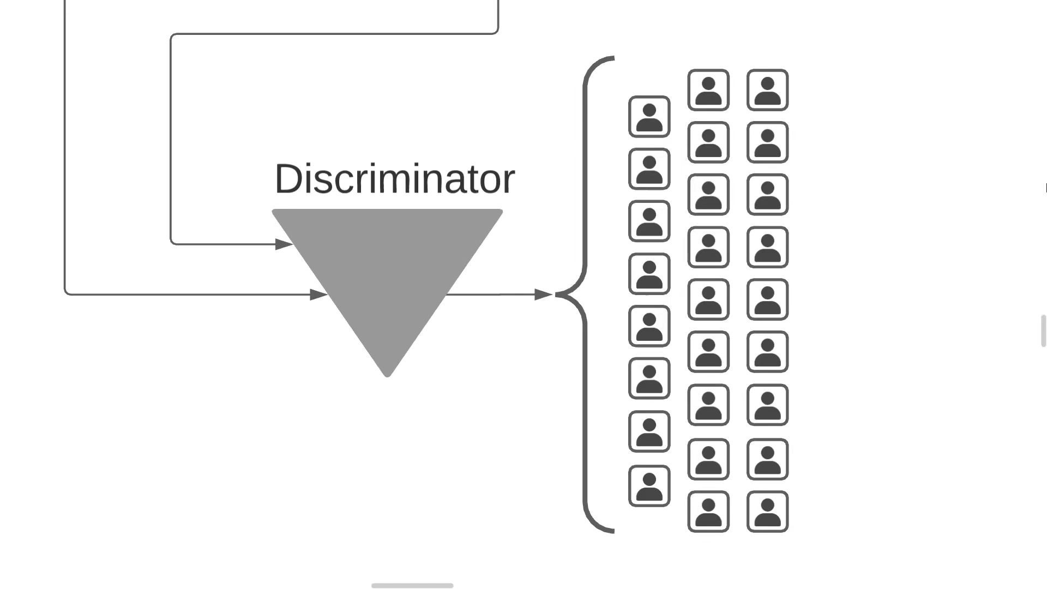
Model Architecture
Source Discriminator
Notes:
Patrick, Nathan

Slide 18
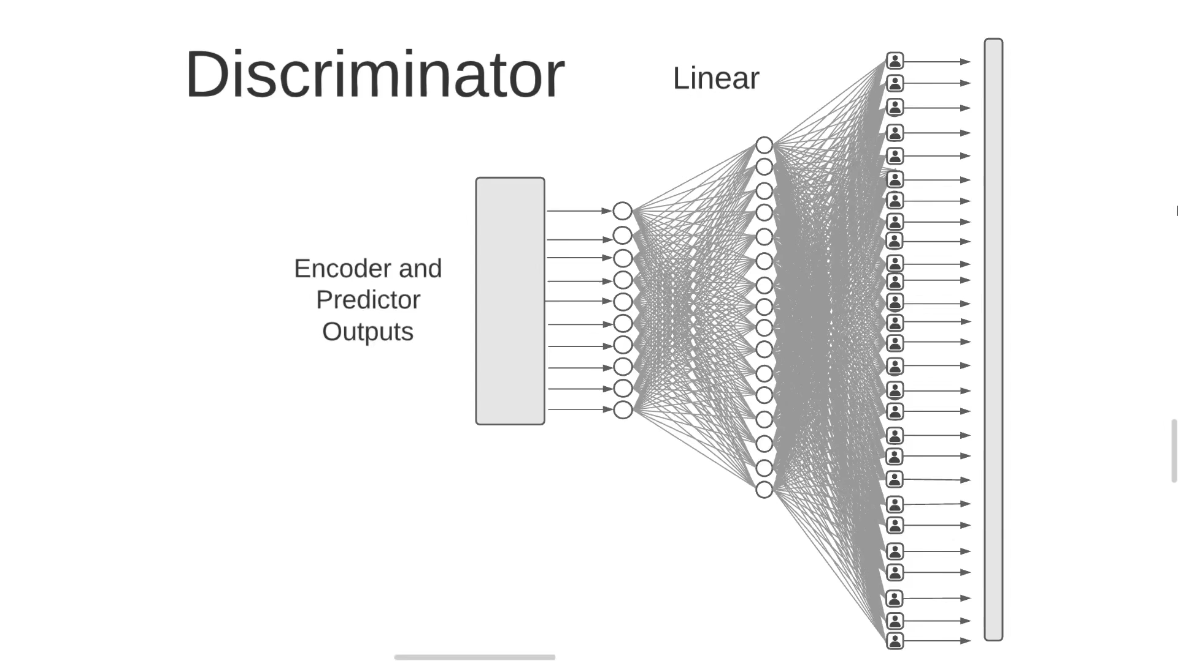
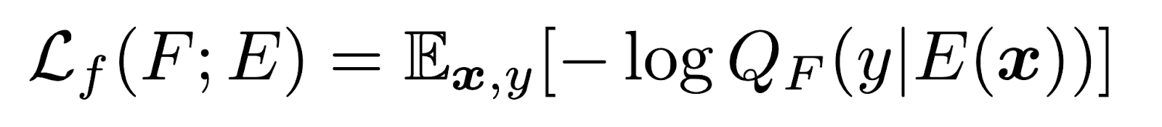
Model Architecture
Encoder
Source Discriminator
Notes:
Patrick, Nathan

Slide 19
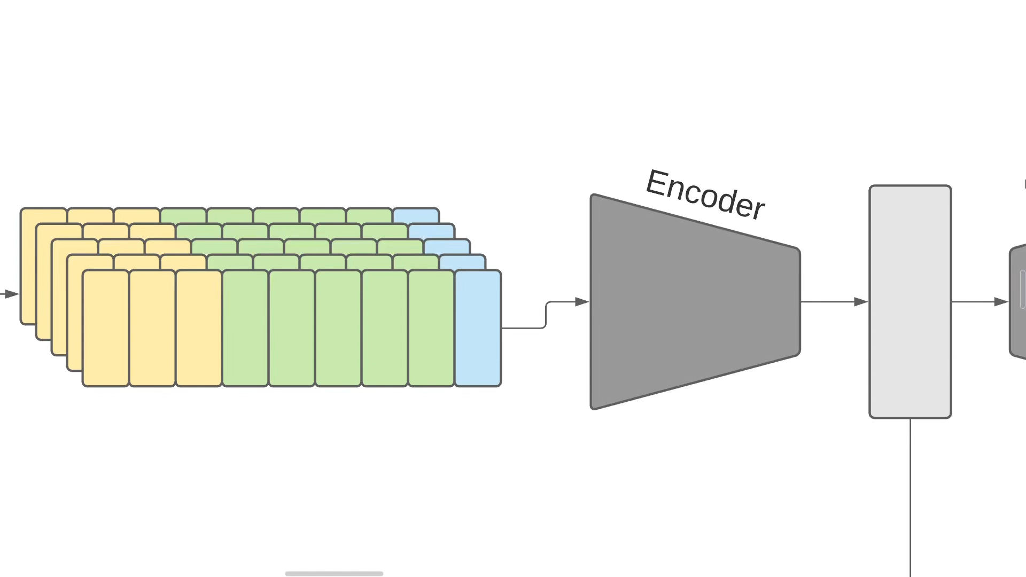
Model Architecture
Encoder
1. CNN
Notes:
Nisha, Mehul

Slide 20
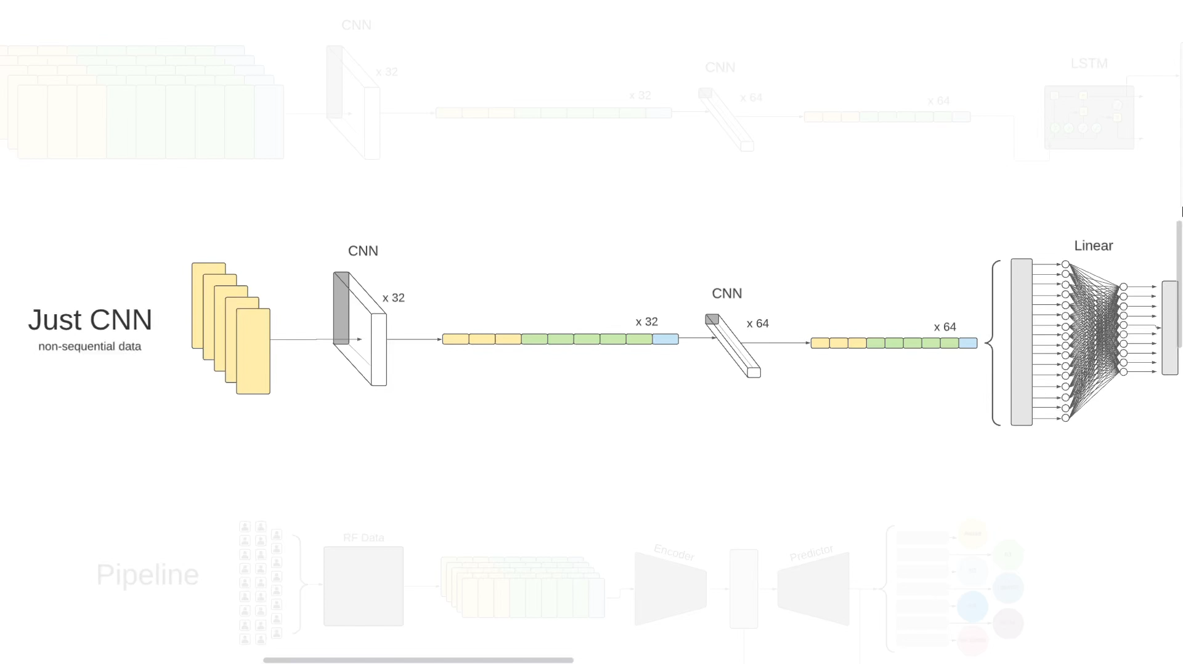
Model Architecture
Encoder
2. CNN + LSTM
1. CNN

Slide 21
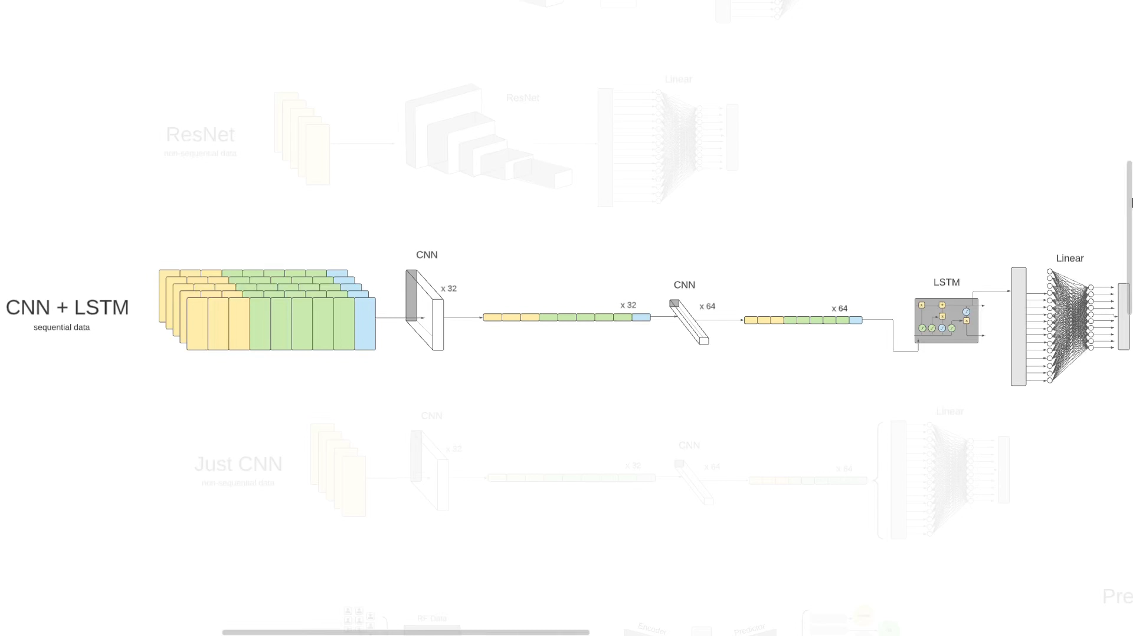
Model Architecture
Encoder
3. ResNet
2. CNN + LSTM

Slide 22
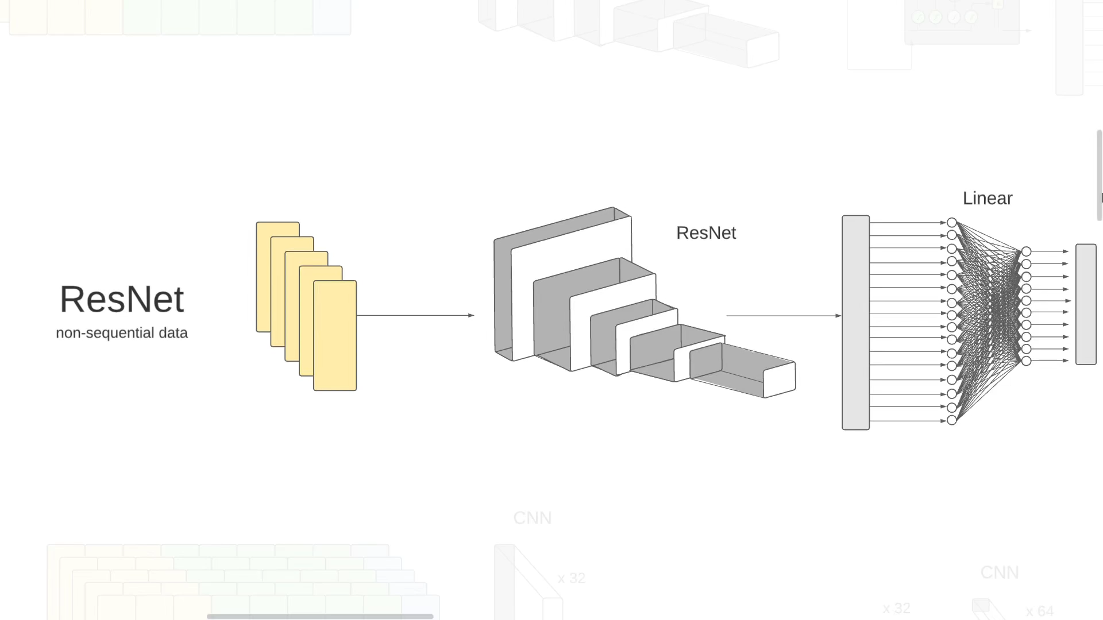
Model Architecture
Encoder
4. ResNet + LSTM
3. ResNet
Notes:
Nisha, Mehul

Slide 23
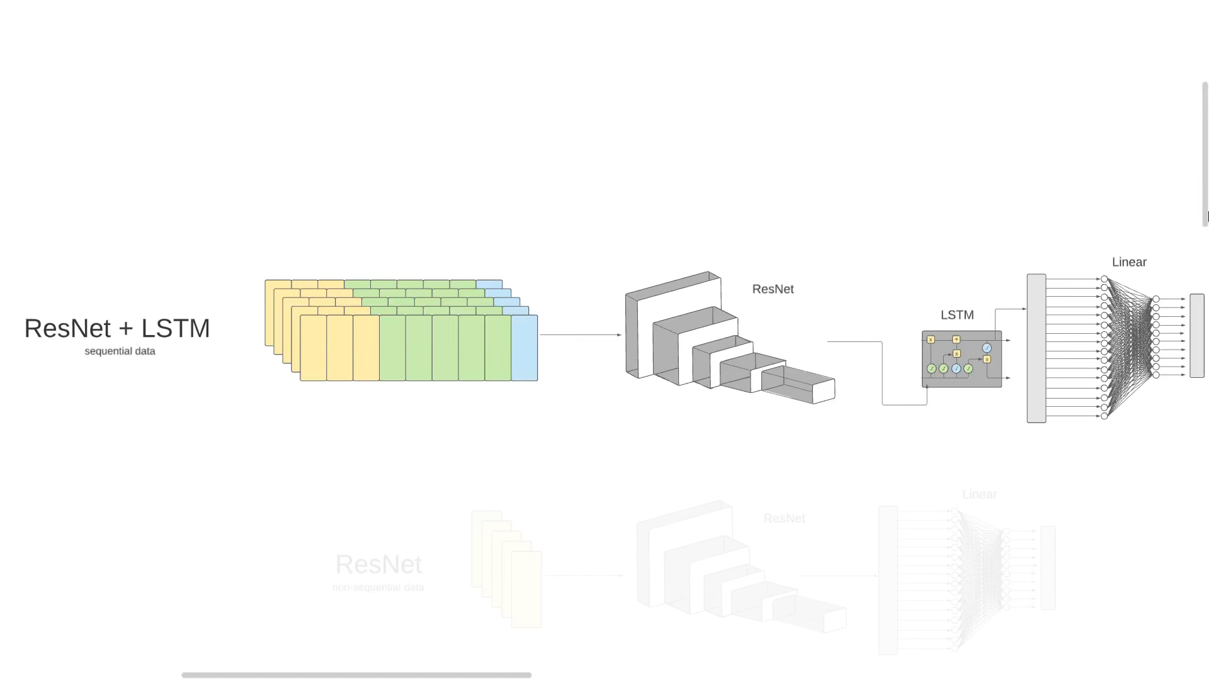
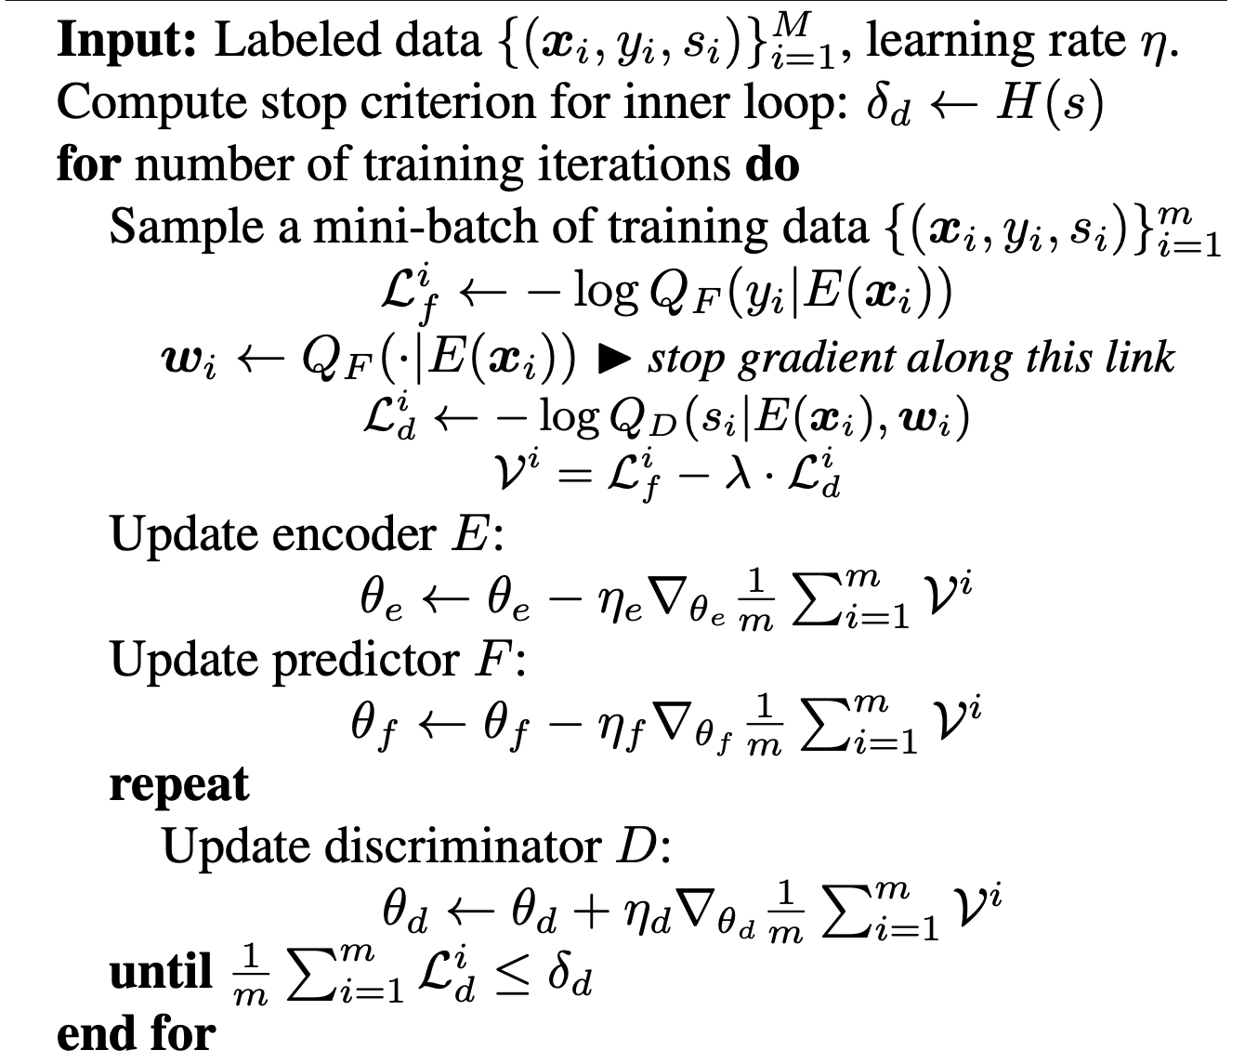
Model Architecture
Encoder
4. ResNet + LSTM
Notes:
Nisha, Mehul

Slide 24
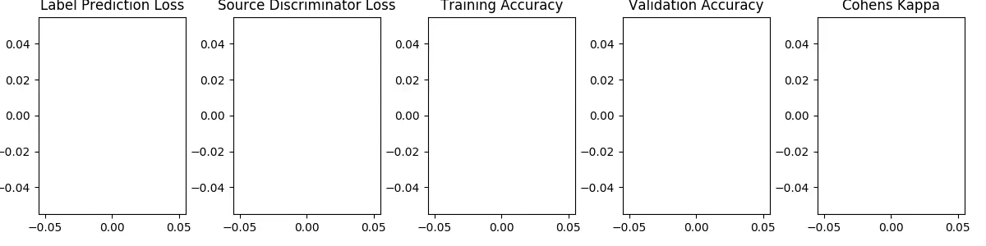
Results
Notes:
Max, Rachel

Slide 25
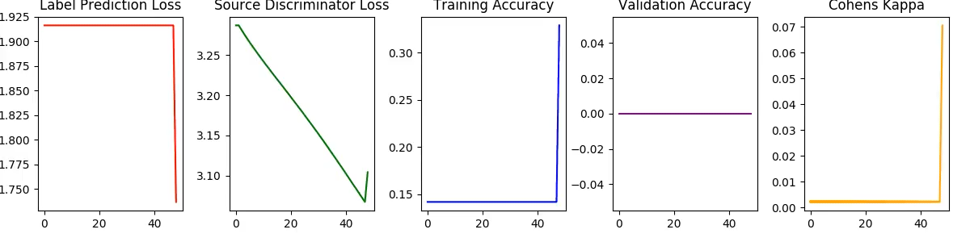
Results
Notes:
Max, Rachel

Slide 26
Web App Interface
https://shallow-sleep.web.app
Notes:
Patrick, Nisha, Rachel

